Slide 2
Standards report
1
1. Blank subtraction
2. RT, Intensity, m/z
3. Smearing
4. Similarity grouping
8. Standards list removal
7. Detection frequency
6. CCS v m/z cutoff
5. Isotopic grouping
9. Post source decay
10. CCS, RT v m/z regression
CCS, m/z, RT target match (Likely)
11. Adduct removal
m/z target match (Tentative)
Fluorinated suspects (no match)
PIMMS report
Algorithms without user tunability
2
Halogen report
3
Tunable algorithms based on user input

Slide 3
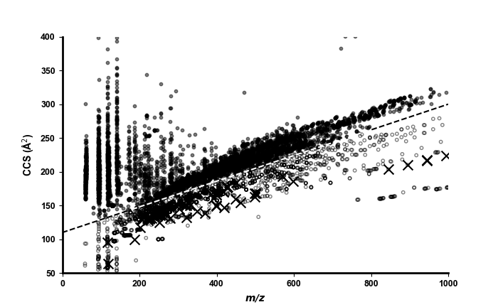
CCS v m/z cutoff
(step 6)
3289 features
1680 features
Point below cutoff
Point above cutoff
PFAS suspect

Slide 4
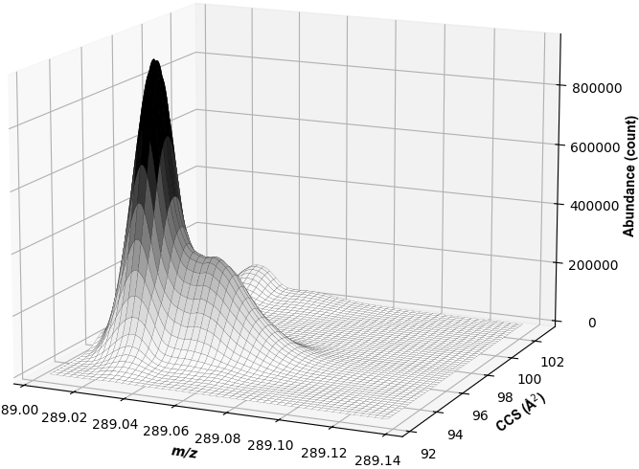
Smearing filter
(step 3)

Slide 5
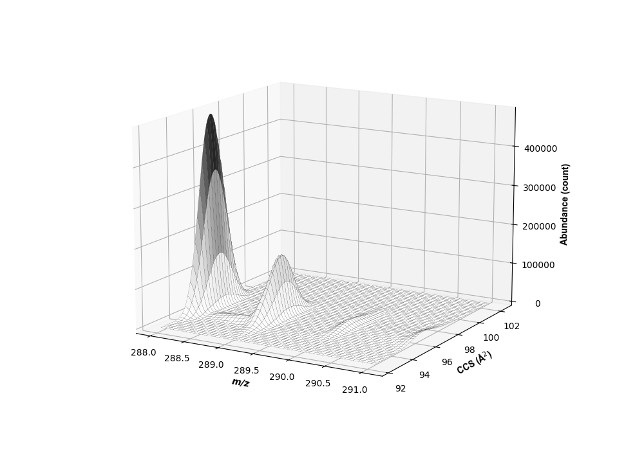
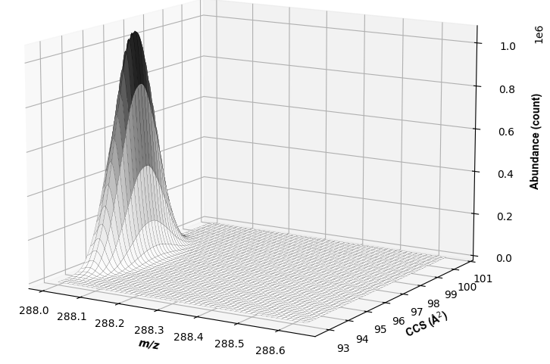
M
M +1
M +2
M +3
Applying isotopic packet filter
(step 5)
M

